Slide 1
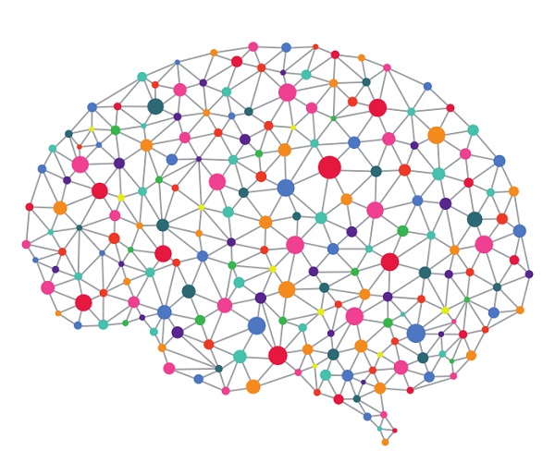

Deep Learning

Slide 2

Contents :
Introduction to deep learning.
The idea behind Machine learning.
Feed Forward neural networks.
Back propagation .
What can go wrong.

Slide 3
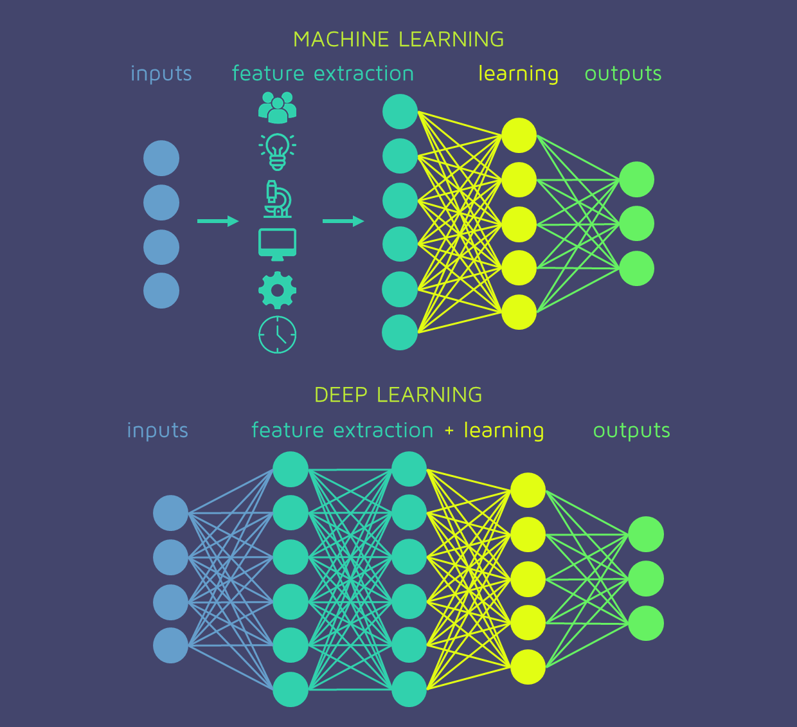

Slide 4
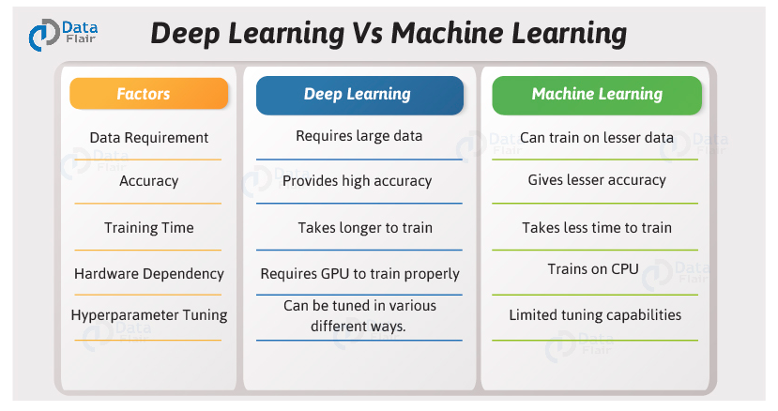

Slide 5
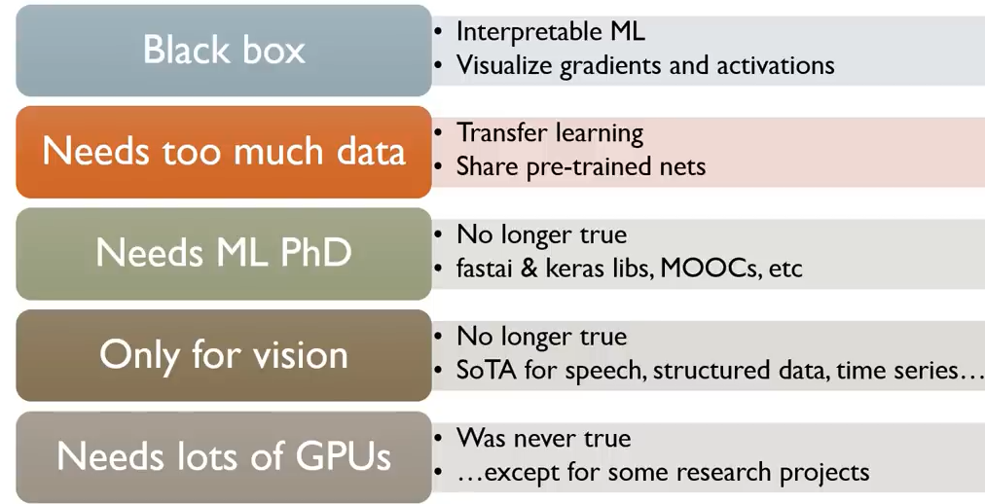
Problems and its solutions in Deep learning

Slide 6


Slide 7

What can deep learning do?

Slide 8


Slide 9
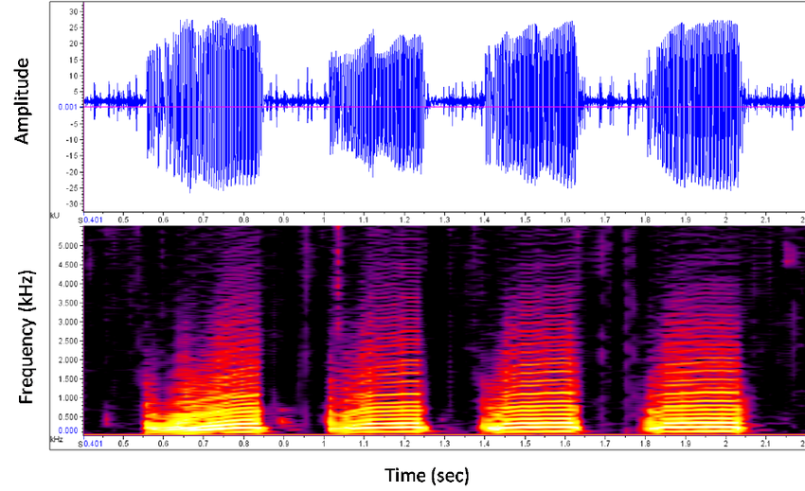
Speech signal analysis. Text to speech. Speech to text. Translation , and Speaker identification and more.

Slide 10
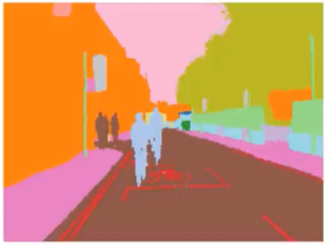

image segmentation .

Slide 11


Slide 12
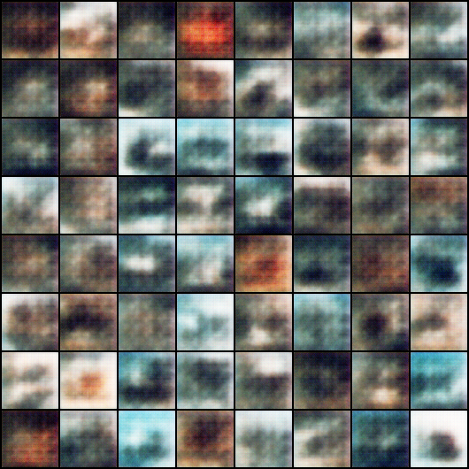
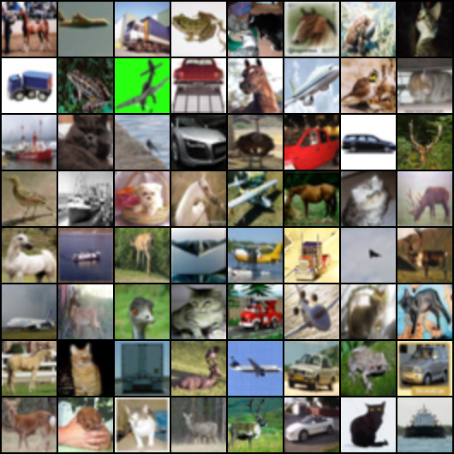
Generative Models (GANs)
Input noise output real looking images

Slide 13
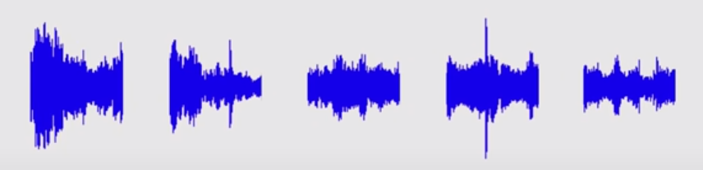
Sequential Data :
Predict the next word in a sentence spoken or written.
Stock Price Predictions.
Predict your sales in the next month or year.
Predict the next frame in a video.

Slide 14


Slide 15
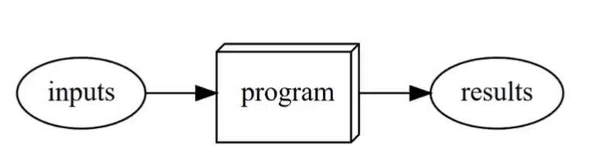

Slide 16
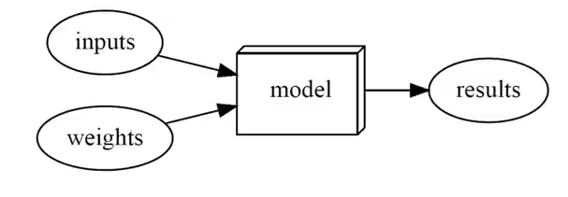

Slide 17
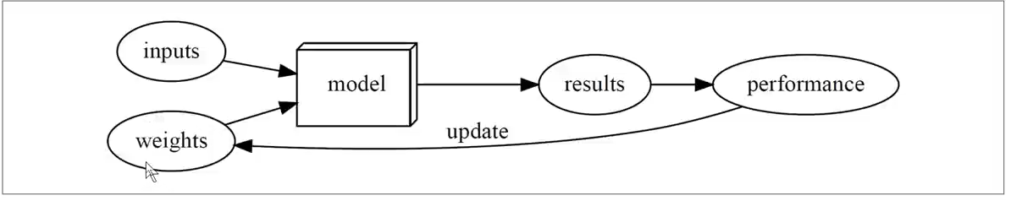

Slide 18
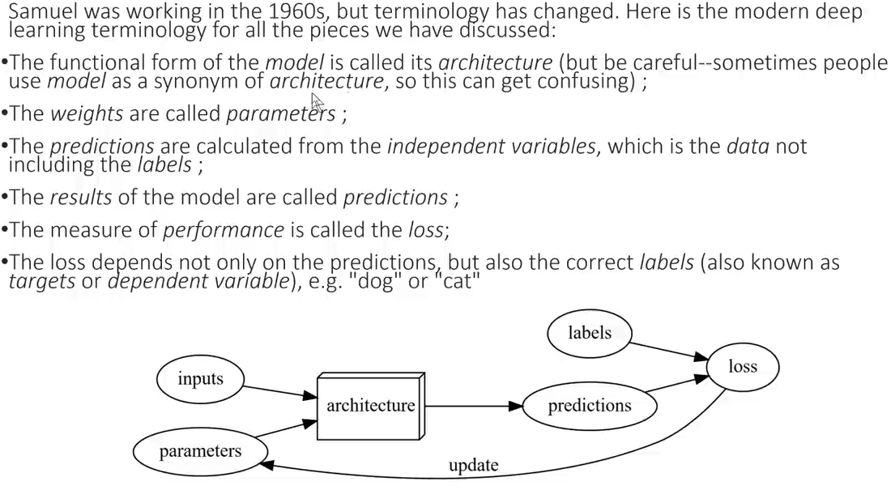

Slide 19
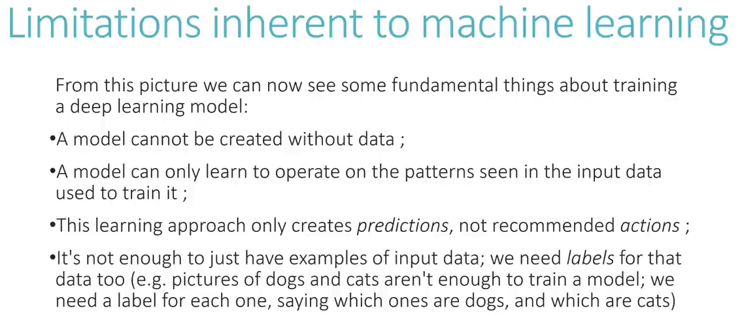

Slide 20
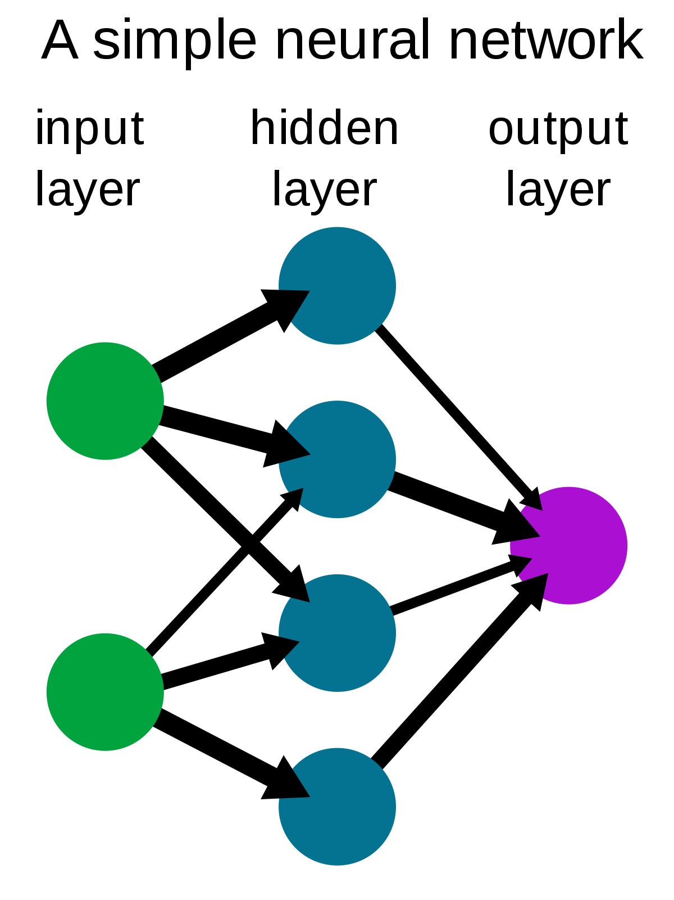
what are the main components of a neural network?
Set of layers : input – hidden – output
Layers are connected with each other with
"weights and biases"
Weights are initialized randomly at first.

Slide 21
How Do we connect the network?

Slide 22
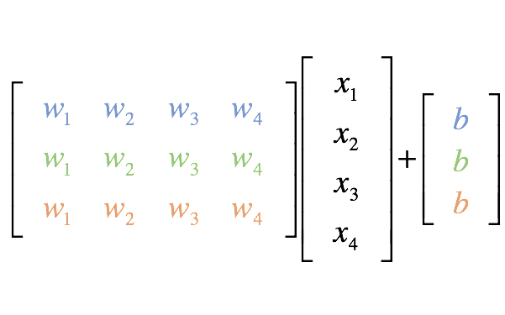
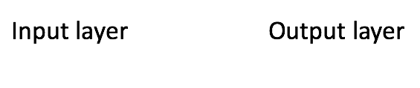
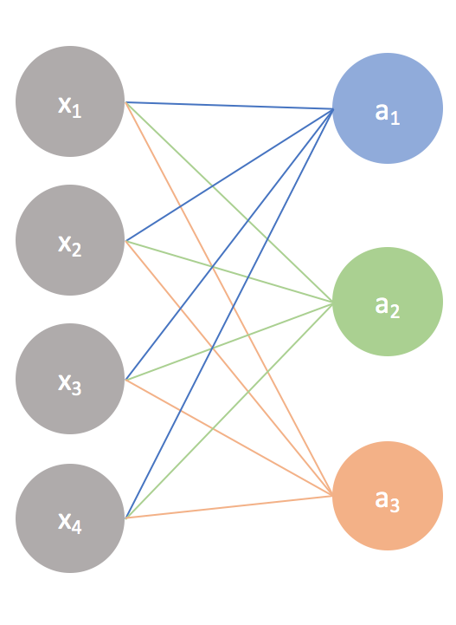
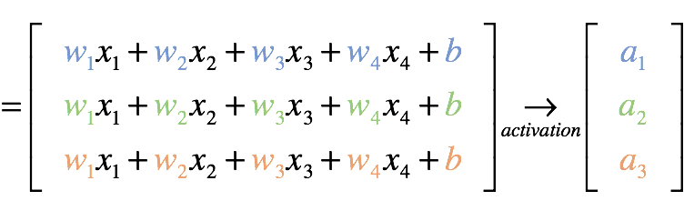
Matrix representation

Slide 23
Definition of activation function:- Activation function decides, whether a neuron should be activated or not.

Slide 24
Explanation :- In a neural network, we would update the weights and biases of the neurons on the basis of the error at the output. This process is known as back-propagation. Activation functions make the back-propagation possible because now we can compute the derivatives.

Slide 25
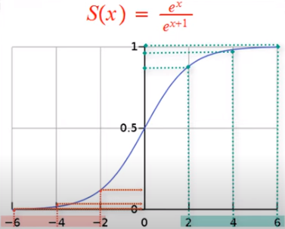
Sigmoid :
- Limits the output between 0 and 1
- Makes the back propagation Possible
- makes the output "Non linear".

Slide 26
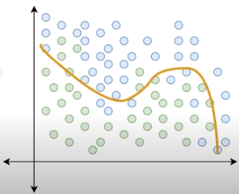
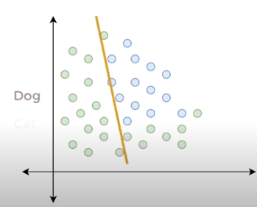
With activation without activation

Slide 27
As an example , if you see a photo of a dog , a certain "neurons" in your brain will be activated

Slide 28
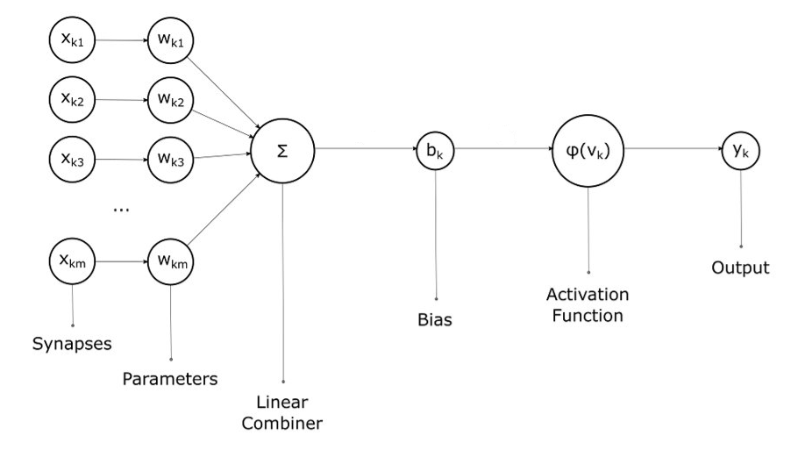

Slide 29
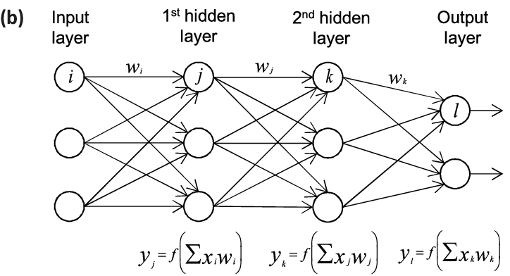
A Fully connected linear neural network.

Slide 30
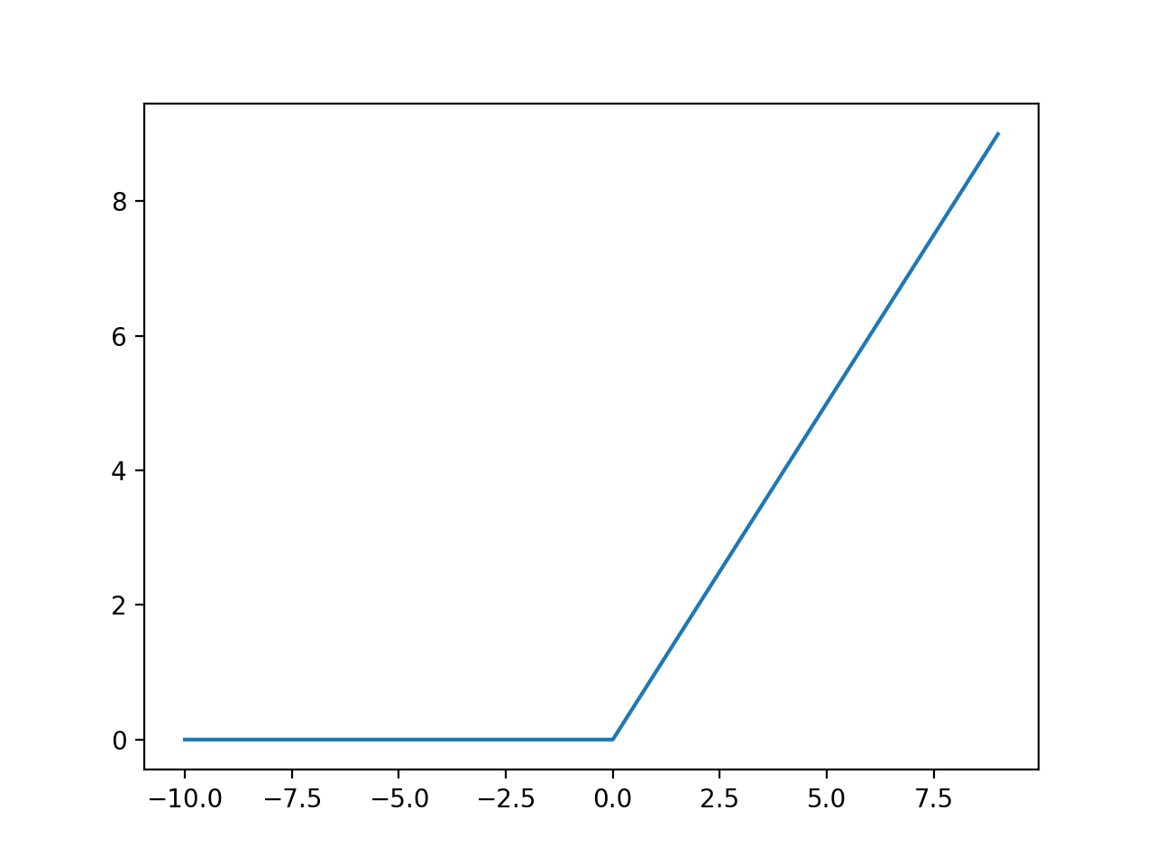
Another commonly used activation function is ReLu(rectified linear unit) :
Relu limits the output between (0 , input)

Slide 31
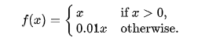
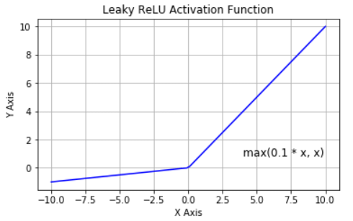
Leaky ReLu :
Leaky ReLu a allows a small range of negative numbers to pass

Slide 32
Which activation function to use at the hidden layers?
Relu
Why ?
It's gradient = 1 faster in computation
And gives better results.

Slide 33
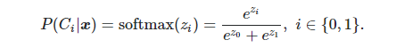
Which activation function to use at the output layer? (classification)
Sigmoid or softmax
Why softmax?
The softmax function, also known as softargmax or normalized exponential function, is often used as the last activation function of a neural network to normalize the output of a network to a probability distribution over predicted output classes

Slide 34
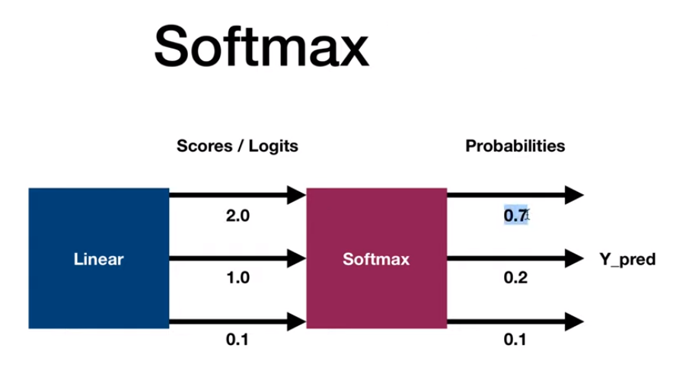

Slide 35
Summary for Feed forward networks :
After taking the activation functions of the weighted sum of the inputs , we get the values of the new layer , which we will repeat the same process to connect to the next layer :
1 . Connect the previous neuron with weights and bais
[X1.w1 + X2.w2 +… + bias]
2. Get the activation function of the output of that new layer
3. Till you reach the output layer (consists of 2 neurons if u want to classify cats vs dogs ) the output now is just a random number between 0 and 1 given zero is a dog and 1 is a cat

Slide 36
Measure the error of your model
(the loss)

Slide 37
Calculating the performance of your model.
equal chance at first.
Calculate loss (error) from labels

Slide 38
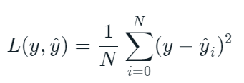
Mean squared error (MSE)
Mean squared error (MSE) is the most commonly used loss function for regression. The loss is the mean overseen data of the squared differences between true and predicted values, or writing it as a formula.

Slide 39
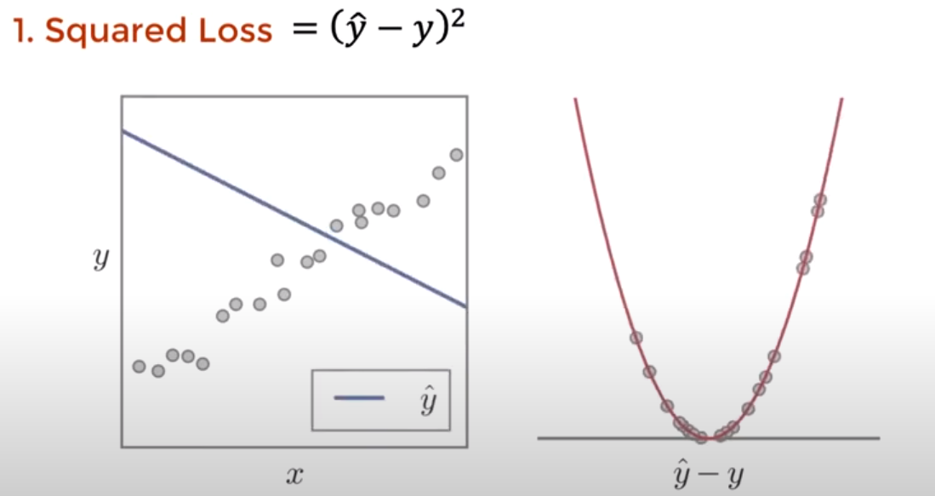
Remember that your loss function before the learning process looks something like this :

Slide 40
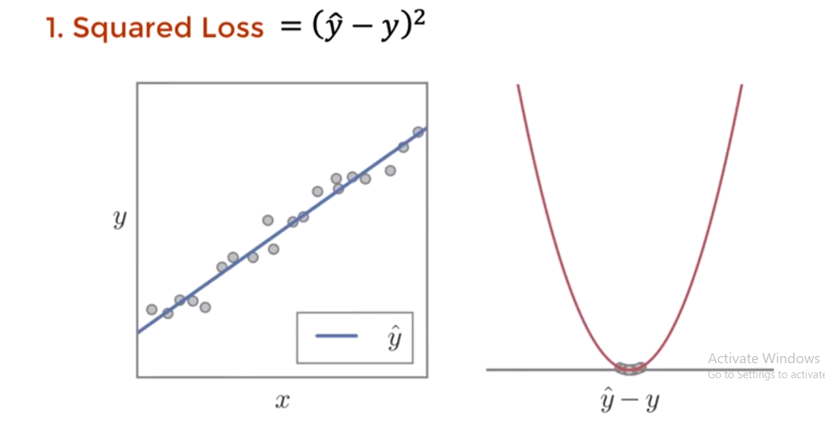
Visualisation of the squared loss.

Slide 41
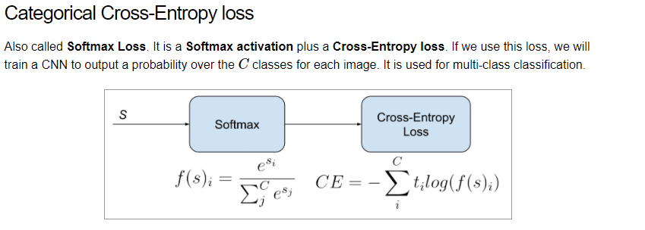

Slide 42
Categorical cross entropy requries the labels to be one hot encoded.

Slide 43
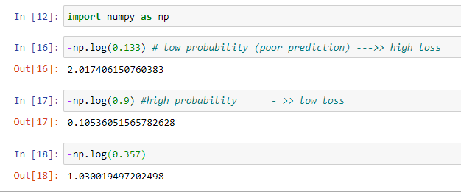
Why Logs?

Slide 44
We need to minimize the loss

Slide 45
Back Propagation

Slide 46
what do we mean by "the network is learning"? It Means that it's finding the weights and biases that minimizes the loss function.

Slide 47
What do we need to do?
1.Calculate the loss on output.
2. SGD minimizes the loss by calculating the gradients of the loss function with respect to the weights
3.Update the weights
4.Repeat

Slide 48
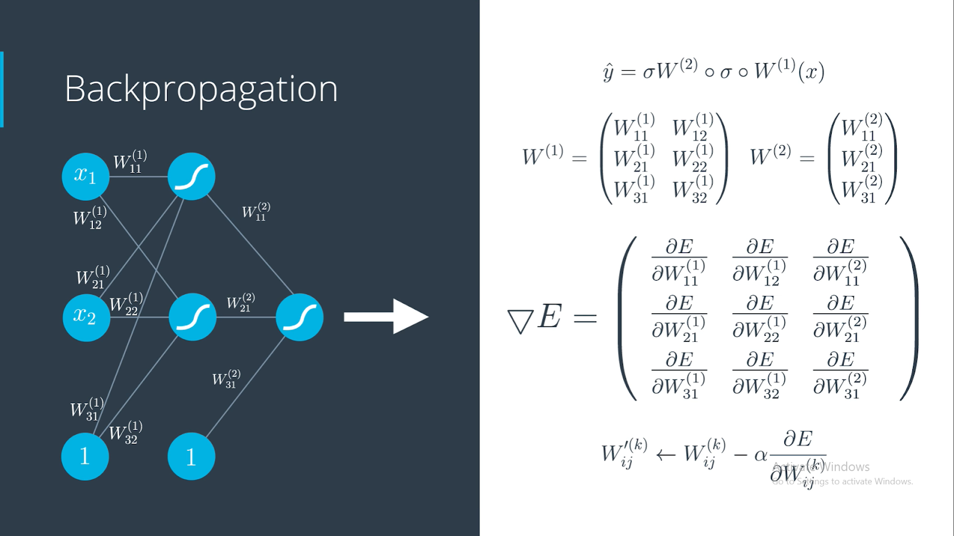

Slide 49
We use the chain rule to calculate the derivatives of the weights.

Slide 50
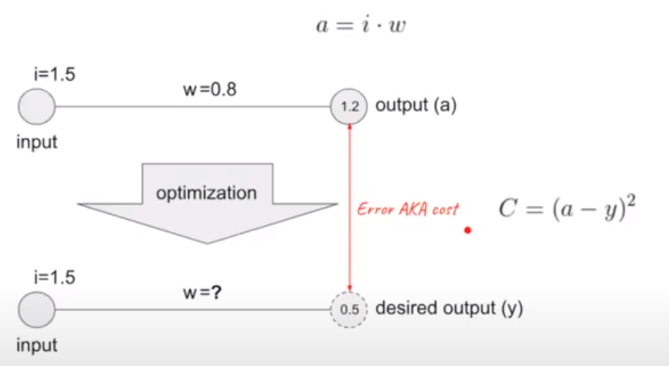

Slide 51
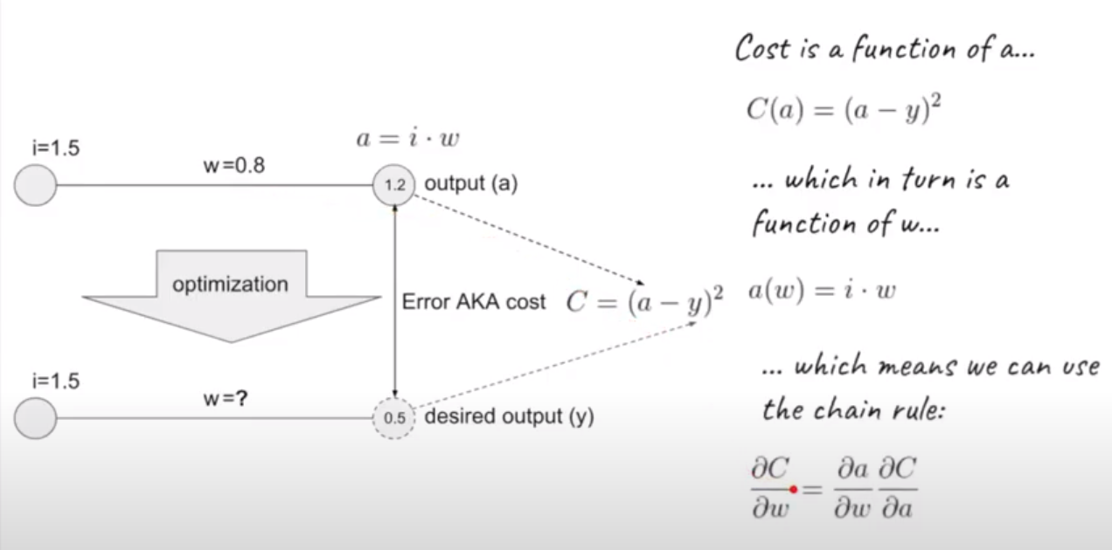

Slide 52
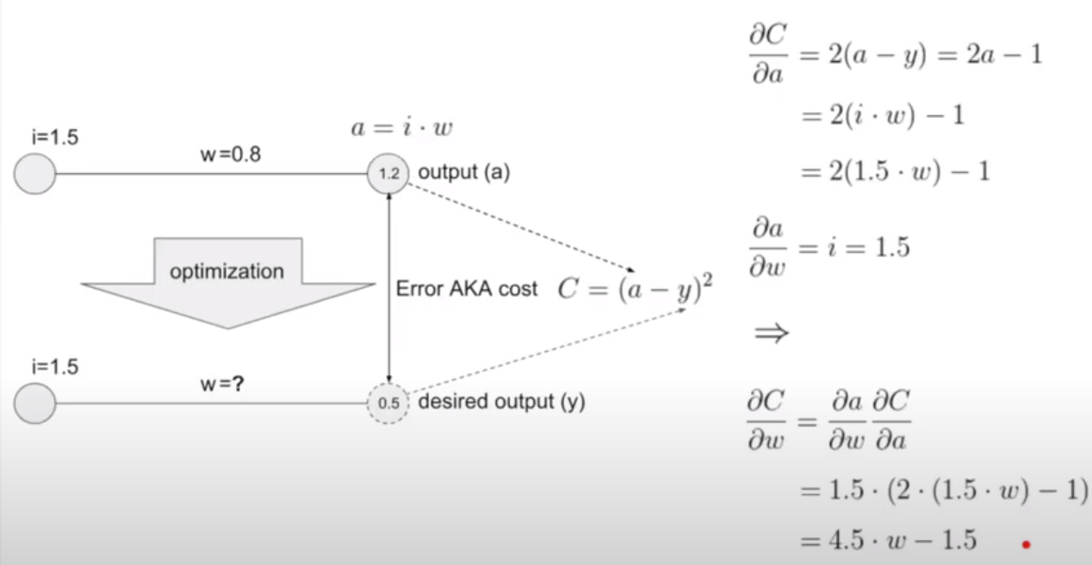

Slide 53
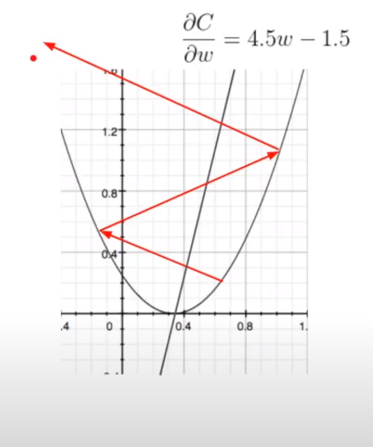
Exploding Gradient Problem
Where the change is going to make your loss bigger not smaller.

Slide 54
Vanishing Gradient :
Taking very small steps.

Slide 55
How do we solve them ?
By adding a new parameter called the learning rate which ranges between 0.000001 and 0.1

Slide 56
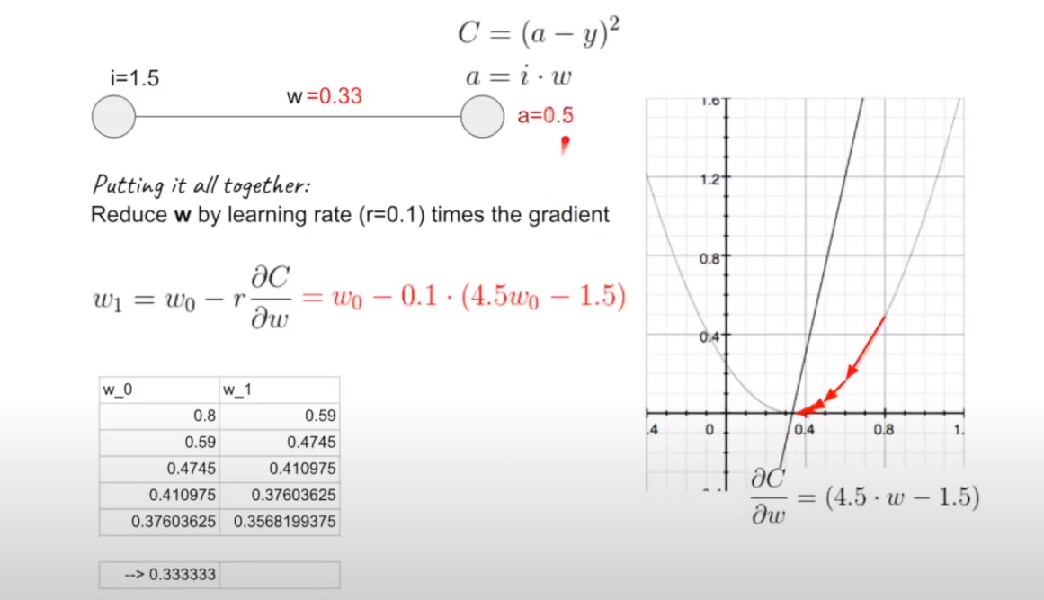

Slide 57
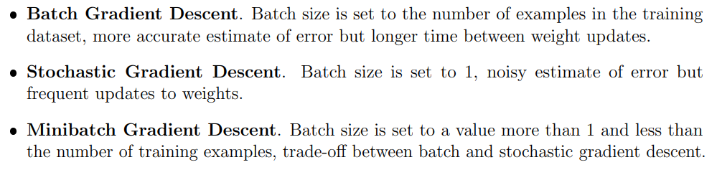

Slide 58
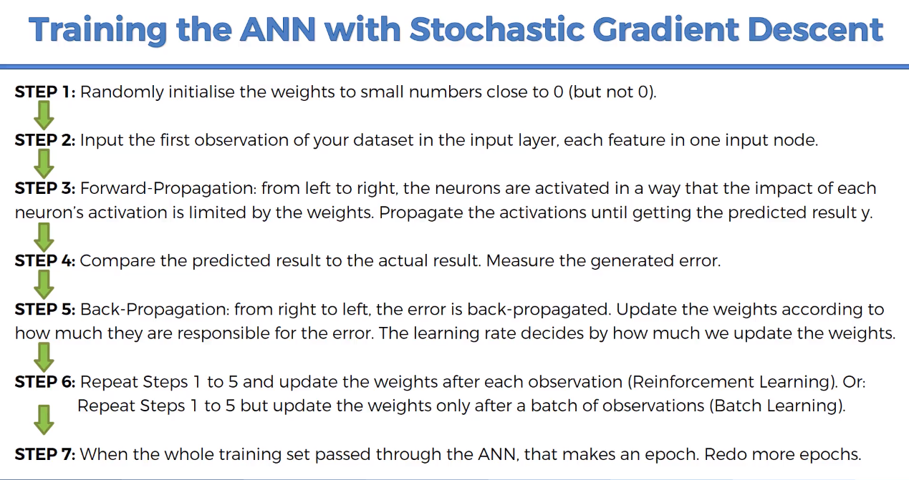

Slide 59
What can go wrong during training? :
1. Choosing the wrong hyperparameters.
2. Data can be Unbalanced.
3. Not enough data.
4. Overfitting – Underfitting – The right fit.

Slide 60
Solutions :
Not enough data or unbalanced --> Data augmentation
Noisy data --> Data preprocessing
Overfitting --> DropOut , Early Stopping , L2 Regularization

Slide 61


Slide 62

Overfitting "complex models"
Overfitting is when the model is doing great on the train test and doing poorly on the validation set , that's why you should always test your model on a data that it had never seen before

Slide 63

Underfitting
Is when your model does poorly on the training set and the validation set.

Slide 64

Regularization :
Regularization is a technique which makes slight modifications to the learning algorithm such that the model generalizes better. This in turn improves the model’s performance on the unseen data as well.

Slide 65
Regularization Techniques :
DropOut
Data Augmentation
Early Stopping

Slide 66
Data Augmentation :
It's a process when you do operations on your data to make the model generalize and to increase Your data
Horizontal and Vertical Shift Augmentation
Horizontal and Vertical Flip Augmentation
Random Rotation Augmentation
Random Brightness Augmentation
Random Zoom Augmentation

Slide 67
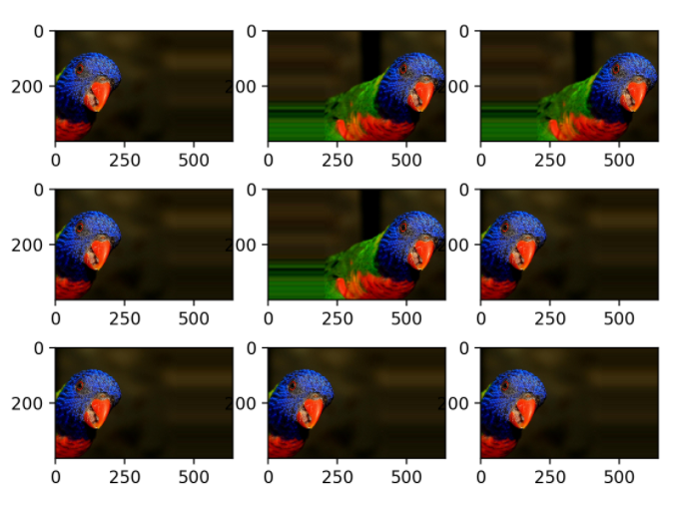

Slide 68
DropOut :
Dropout is a regularization method that approximates training a large number of neural networks with different architectures in parallel.
During training, some number of layer outputs are randomly ignored or “dropped out.” This has the effect of making the layer look-like and be treated-like a layer with a different number of nodes and connectivity to the prior layer.

Slide 69
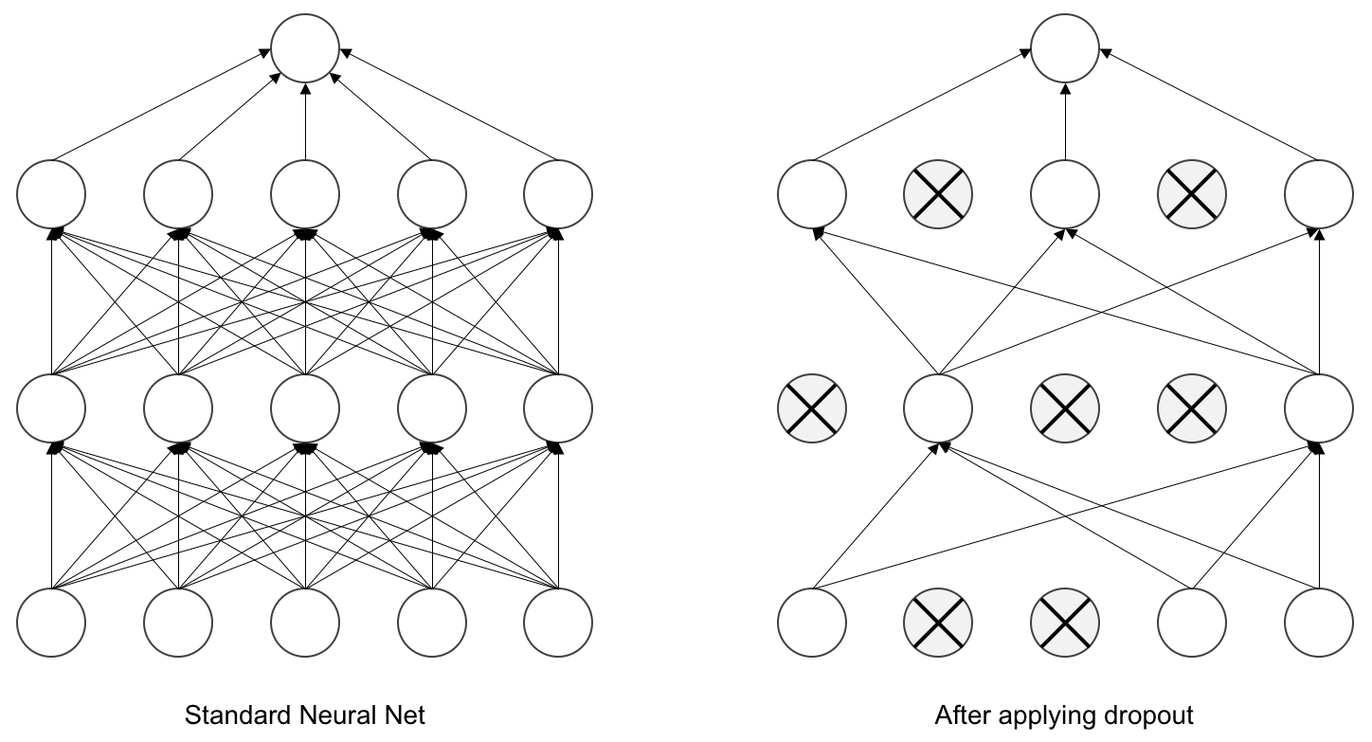

Slide 70
Early Stopping :
Stops Training When Generalization Error Increases
How to stop ?
Monitoring model performance.
Trigger to stop training.
The choice of model to use.

Slide 71
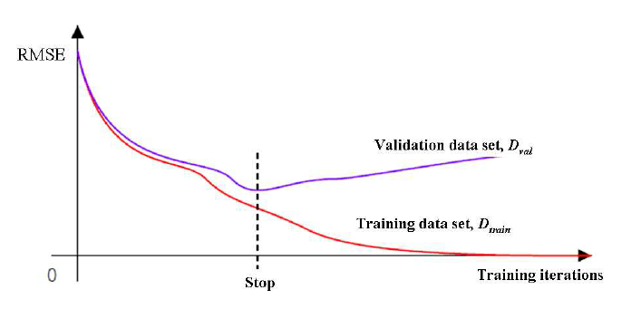

Slide 72
Summary of Session 1.
Machine learning models' pipeline
Linear neural network (MLP)
Activation functions and loss functions (Relu , Sigmoid , softmax) , (mse , cross entropy)
Backpropagation (Stochastic Gradient descent) (chain rule)
Regularization

Slide 73
Your tasks.
Read more about backpropagation
Watch a video about Adam (another optimization algorithm)
Read about how initializing weights affects the training and another techniques of initializing weights like "xavier initalization"

Slide 74


